Slide 1
Final Year Project
Session 2022–2026 | 8th Semester
SYNC
TEAM MEMBERS
Aqsa Shehzad
Team Lead
BSCS51F22S028
AI-Powered Healthcare Platform
Farwa Eiman Arif
Team Member
BSCS51F22S014
for Pakistan
Sehrish Akram
Team Member
BSCS51F22S019
Ayesha
Team Member
BSCS51F21R036
SUPERVISORS
Project Supervisor: Prof. Dr. Hafiz Muhammad Faisal Shehzad
Project Manager: Prof. Dr. Muhammad Ilyas
University of Sargodha — Department of Computer Science

Slide 2

WHAT IS SYNC?
Project Overview
"Connecting patients with the right doctors
through intelligent, AI-driven healthcare for Pakistan."
🤖
📋
Doctor Discovery
AI Health Agent
Patient Management
Browse & filter PMC-verified doctors by specialty, city, fees, and availability. Four consultation types supported.
Conversational AI powered by Groq LLM and RAG pipeline grounded in MedlinePlus, CDC, WHO, NHS & Mayo Clinic data.
Manage appointments, prescriptions, visit history, and follow-ups , all in one personalized patient dashboard.

Slide 3
PROBLEM & SOLUTION
Why Sync Exists
THE PROBLEM
SYNC'S SOLUTION
No reliable way to find verified, licensed doctors
PMC-verified doctor directory with smart filters
No digital prescription or visit history tracking
Digital prescriptions & full visit history
Patients receive generic advice without context
AI agent with persistent patient memory & RAG
Appointment booking is manual and fragmented
Unified appointment system (online, physical, home)
No AI guidance to navigate healthcare system
Evidence-based guidance from trusted medical sources

Slide 4
WHAT THE SYSTEM DOES
Functional Requirements
FR-01
FR-04
User Registration & Authentication
Appointment Booking
Patients and doctors register with role-specific fields. JWT-based session with dual-layer verification via Supabase.
Patient books slots with unique constraint (no double-booking). Supports online video, chat, physical, and home visit.
FR-02
FR-05
PMC Doctor Verification
AI Health Agent
System automatically verifies doctors' PMC numbers via background task on registration. Status: pending → verified.
LangChain + Groq LLM with 10 patient-bound tools. RAG from medical sources. Max 8 iterations. 60s timeout guard.
FR-03
FR-06
Doctor Directory & Search
Prescription & Visit Tracking
Public directory filtered by specialty, city, fees, and consultation type. Only verified doctors appear.
Doctors write digital prescriptions. Patients view active prescriptions and past visit notes from their dashboard.

Slide 5
LANGUAGES & TECHNOLOGIES
Tech Stack
Frontend
Backend
Database
AI Layer
◆ React 19 + TypeScript
◆ Python + FastAPI
◆ PostgreSQL
◆ LangChain AgentExecutor
◆ Vite 7
◆ Pydantic
◆ Supabase (Auth + DB)
◆ Groq LLM (Kimi K2)
◆ Tailwind CSS
◆ SQLAlchemy
◆ Qdrant Vector Store
◆ Voyage-3-lite Embeddings
◆ shadcn/ui
◆ Alembic
◆ bcrypt hashing
◆ RAG Pipeline
◆ React Router v6
◆ Pytest

Slide 6
HOW THE SYSTEM IS BUILT
System Architecture
React Frontend
FastAPI Backend
PostgreSQL / Supabase
TypeScript · Vite · Tailwind
React Router · shadcn/ui
HTTP/REST
SQLAlchemy
Users · Doctors · Patients
Appointments · Prescriptions
Services · Routers · Schemas
AI Agent
Qdrant Vector Store
Supabase Auth
Medical knowledge RAG
LangChain · Groq · RAG · Memory
JWT · Session management
Medical Sources: MedlinePlus · CDC · WHO · NHS · Mayo Clinic

Slide 7
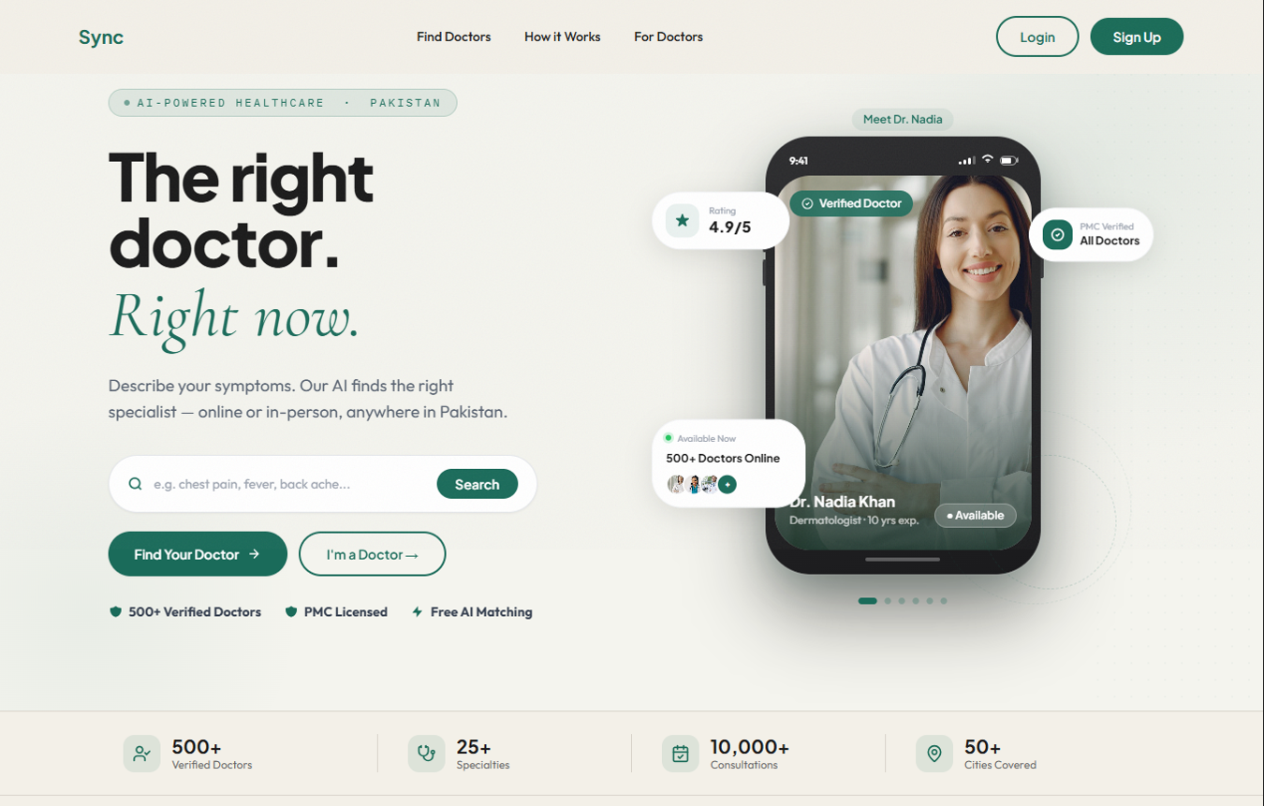
GUI SCREEN 01
Landing Page

Slide 8
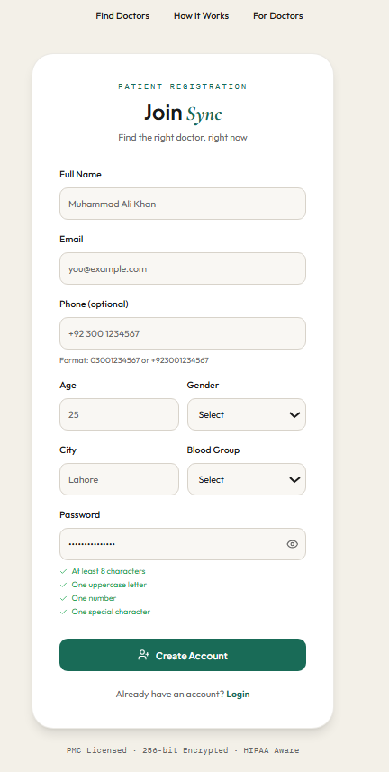
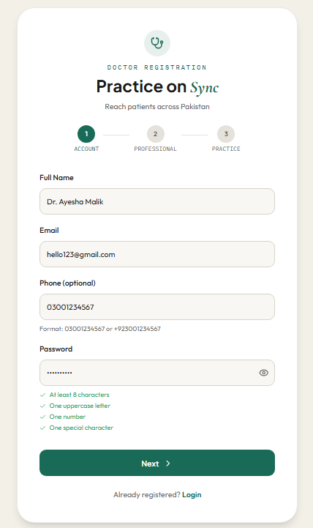
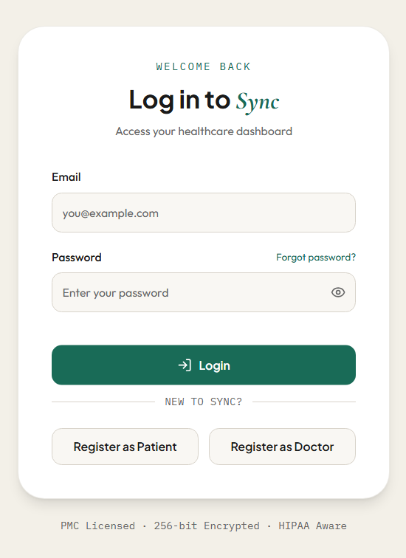
GUI SCREEN 02
Login & Registration

Slide 9
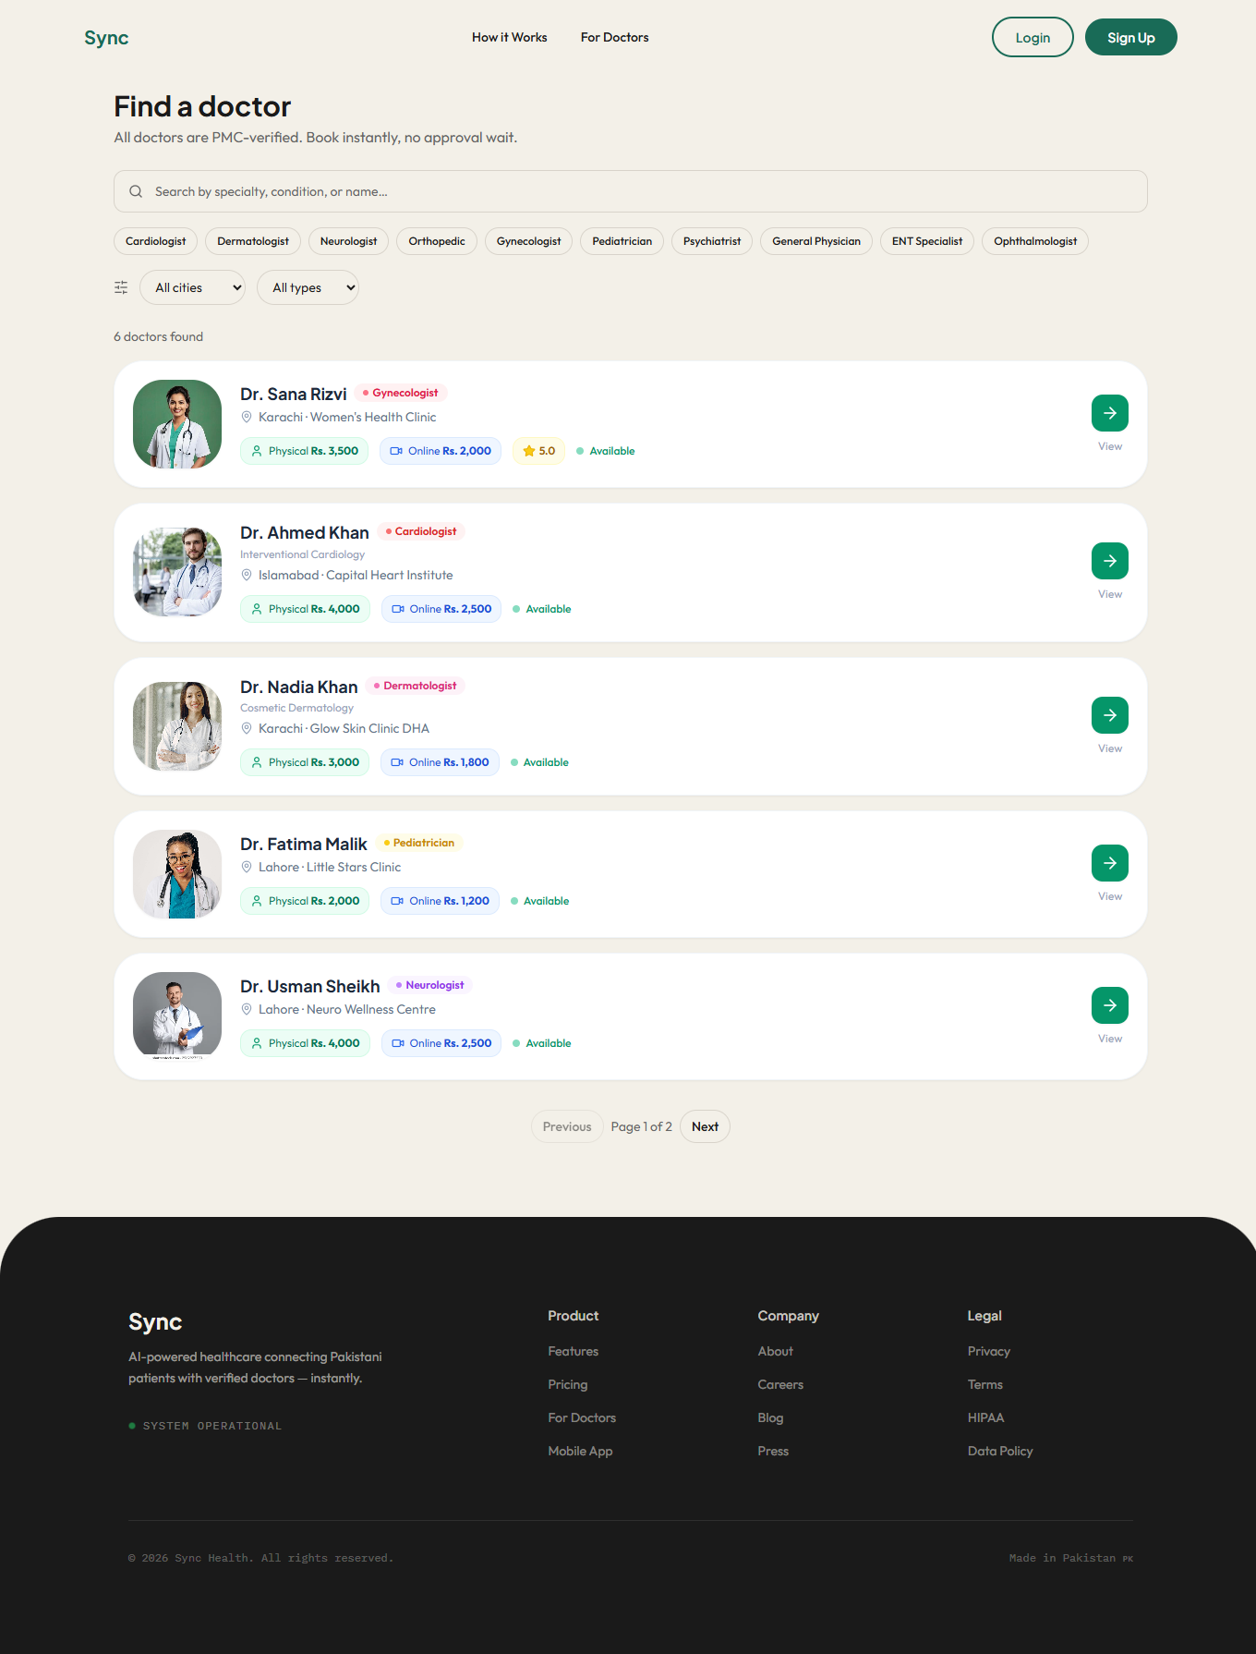
GUI SCREEN 03
Doctor Directory
This is a Doctor Directory screen for Sync. It lets users search and browse through a list of verified doctors across Pakistan.
You can filter by specialty like Cardiologist, Dermatologist, or Pediatrician, or narrow it down by city and appointment type.
Each doctor card shows their name, specialty, clinic location, and both physical and online consultation fees in PKR. There's also a quick availability status so you know who's ready to book right now.
It's clean, simple, and built to help patients find the right doctor without any hassle.

Slide 10
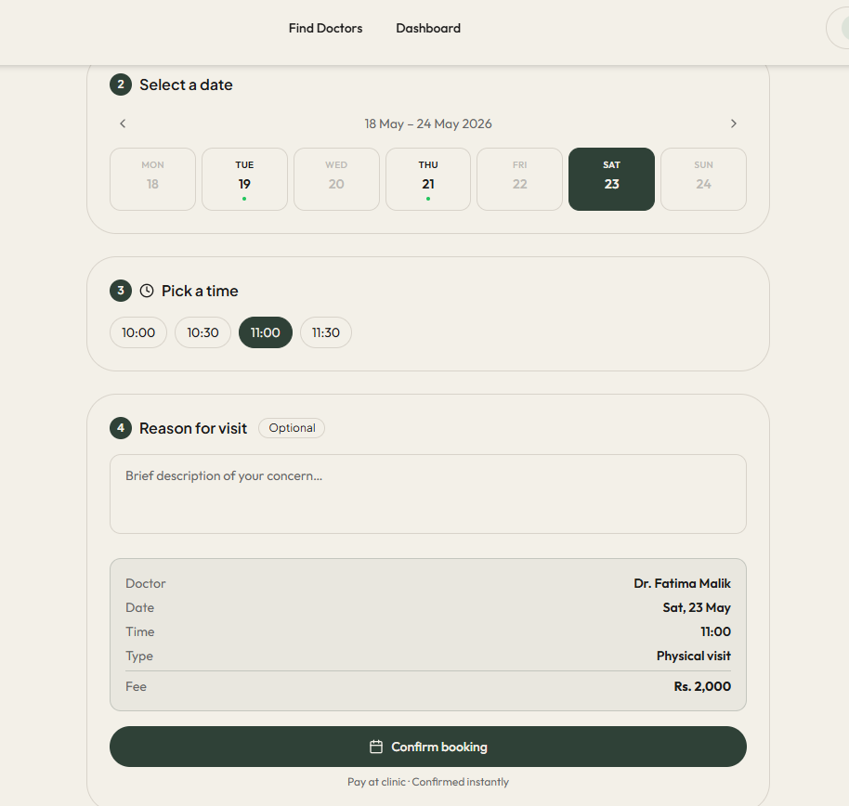
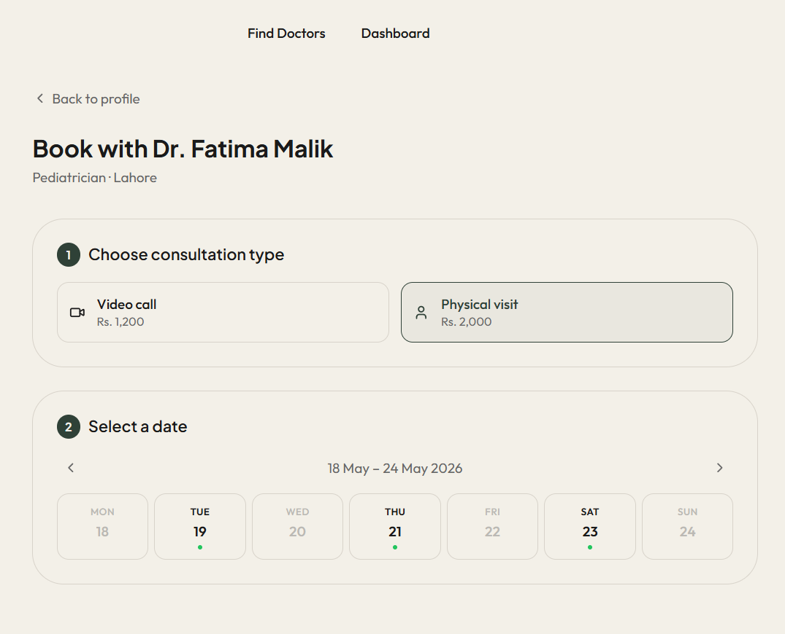
GUI SCREEN 04
Appointment Booking
This is the Appointment Booking screen where users can schedule a visit with their chosen doctor.
The flow is straightforward. You first pick your consultation type, either a video call or a physical visit, each with its own fee clearly displayed. Then you select a date from the weekly calendar and choose a time slot that works for you.
There's even an optional field to briefly describe your concern before booking.
Before confirming, a neat summary shows all your details: doctor, date, time, type, and fee, so nothing feels uncertain. One tap on Confirm Booking and you're done. No back and forth, no confusion.

Slide 11
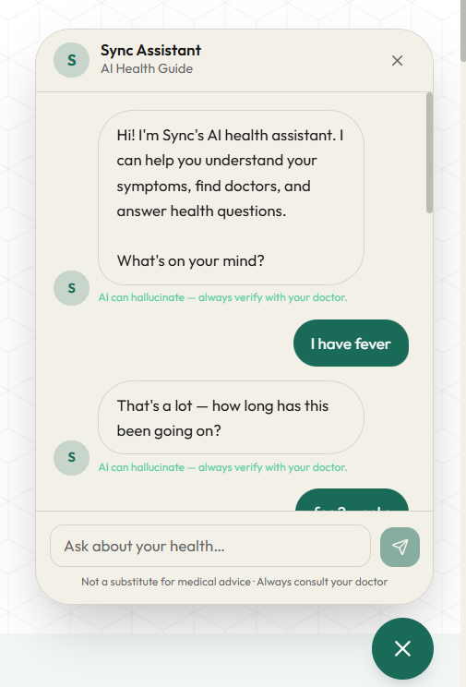
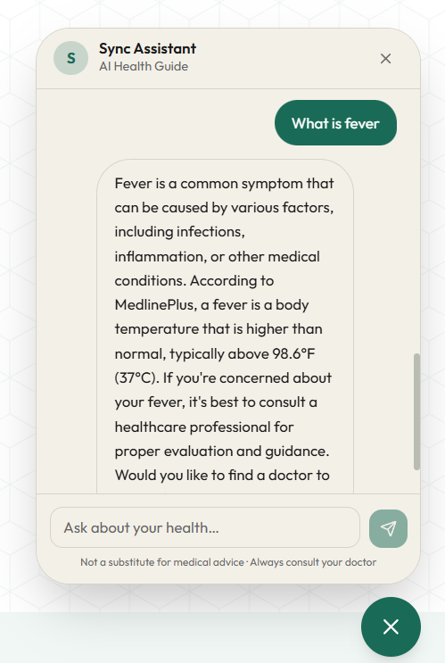
GUI SCREEN 05
AI Health Agent
Patient Memory
Agent recalls past visits and prescriptions at every session.
RAG Grounding
Answers backed by MedlinePlus, CDC, WHO, NHS, Mayo Clinic.
10 Patient Tools
find_doctors, book_appointment, get_prescriptions + 7 more.
Safety Guardrails
Regex scan: never diagnoses, never prescribes, adds disclaimer.

Slide 12
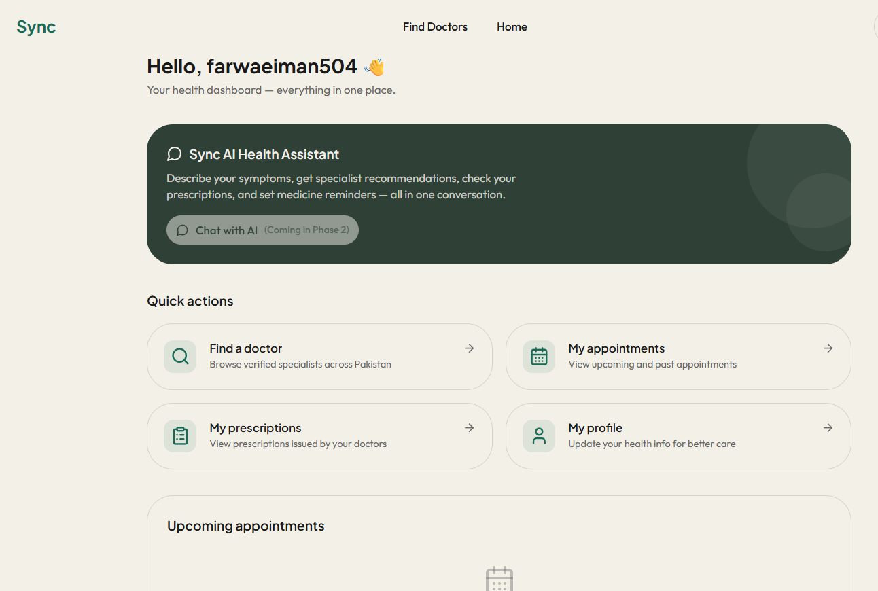
GUI SCREEN 06
Patient Dashboard
Once logged in, patients land on a clean personal dashboard that puts everything health-related in one place.
The Sync AI Health Assistant lets patients describe symptoms and get specialist recommendations instantly.
Four quick action cards handle the essentials : find a doctor, view appointments, check prescriptions, and update your health profile.
Upcoming appointments sit right on the home screen, so nothing ever slips through the cracks.

Slide 13
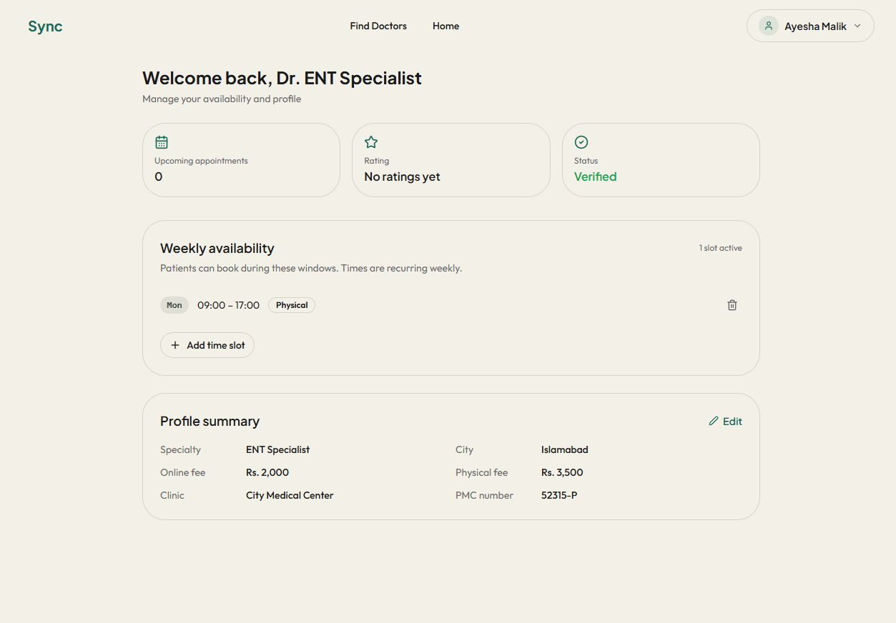
GUI SCREEN 07
Doctor Dashboard
Doctors land on a focused dashboard showing their upcoming appointments, rating, and verification status at a glance.
They can set recurring weekly availability slots so patients always know when to book.
A profile summary keeps their specialty, fees, clinic, and PMC number organized, all editable in one place.

Slide 14
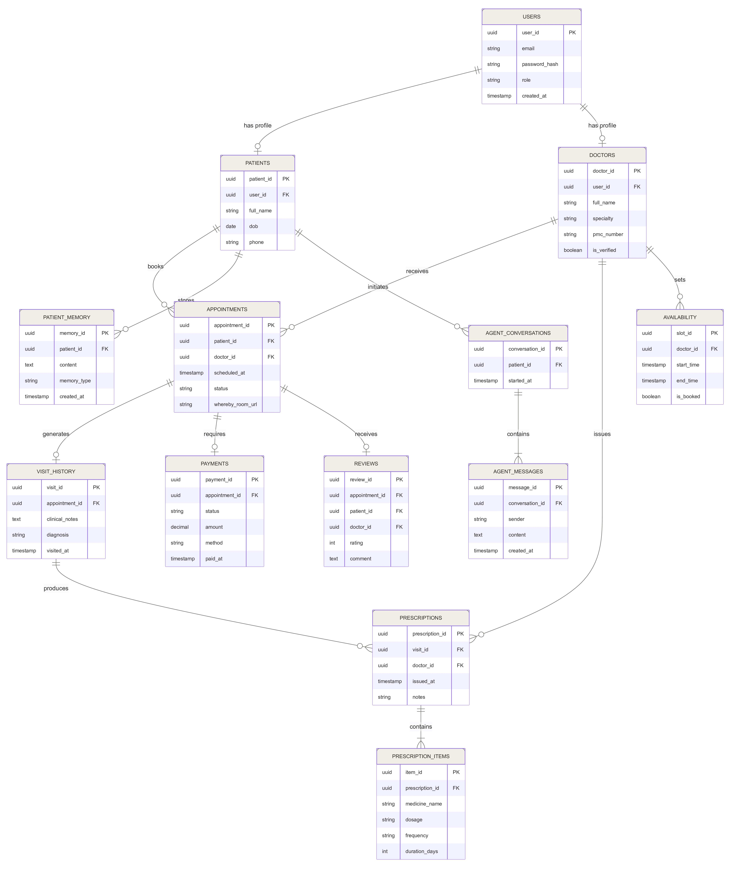
DATA RELATIONSHIPS
Logical Data Model
The logical data model of SYNC consists of 13 interrelated entities. The USERS table branches into PATIENTS and DOCTORS profiles, connected through APPOINTMENTS at the core.
Each appointment generates VISIT_HISTORY, which produces PRESCRIPTIONS and PRESCRIPTION_ITEMS. Payments and reviews are also linked per appointment.
The AI layer is captured through AGENT_CONVERSATIONS and AGENT_MESSAGES. PATIENT_MEMORY stores conversation context as vector embeddings, enabling RAG-based retrieval for personalized and context-aware AI responses.
Doctor availability is managed via the AVAILABILITY table, ensuring proper slot booking and scheduling.
User
Appointment

Slide 15
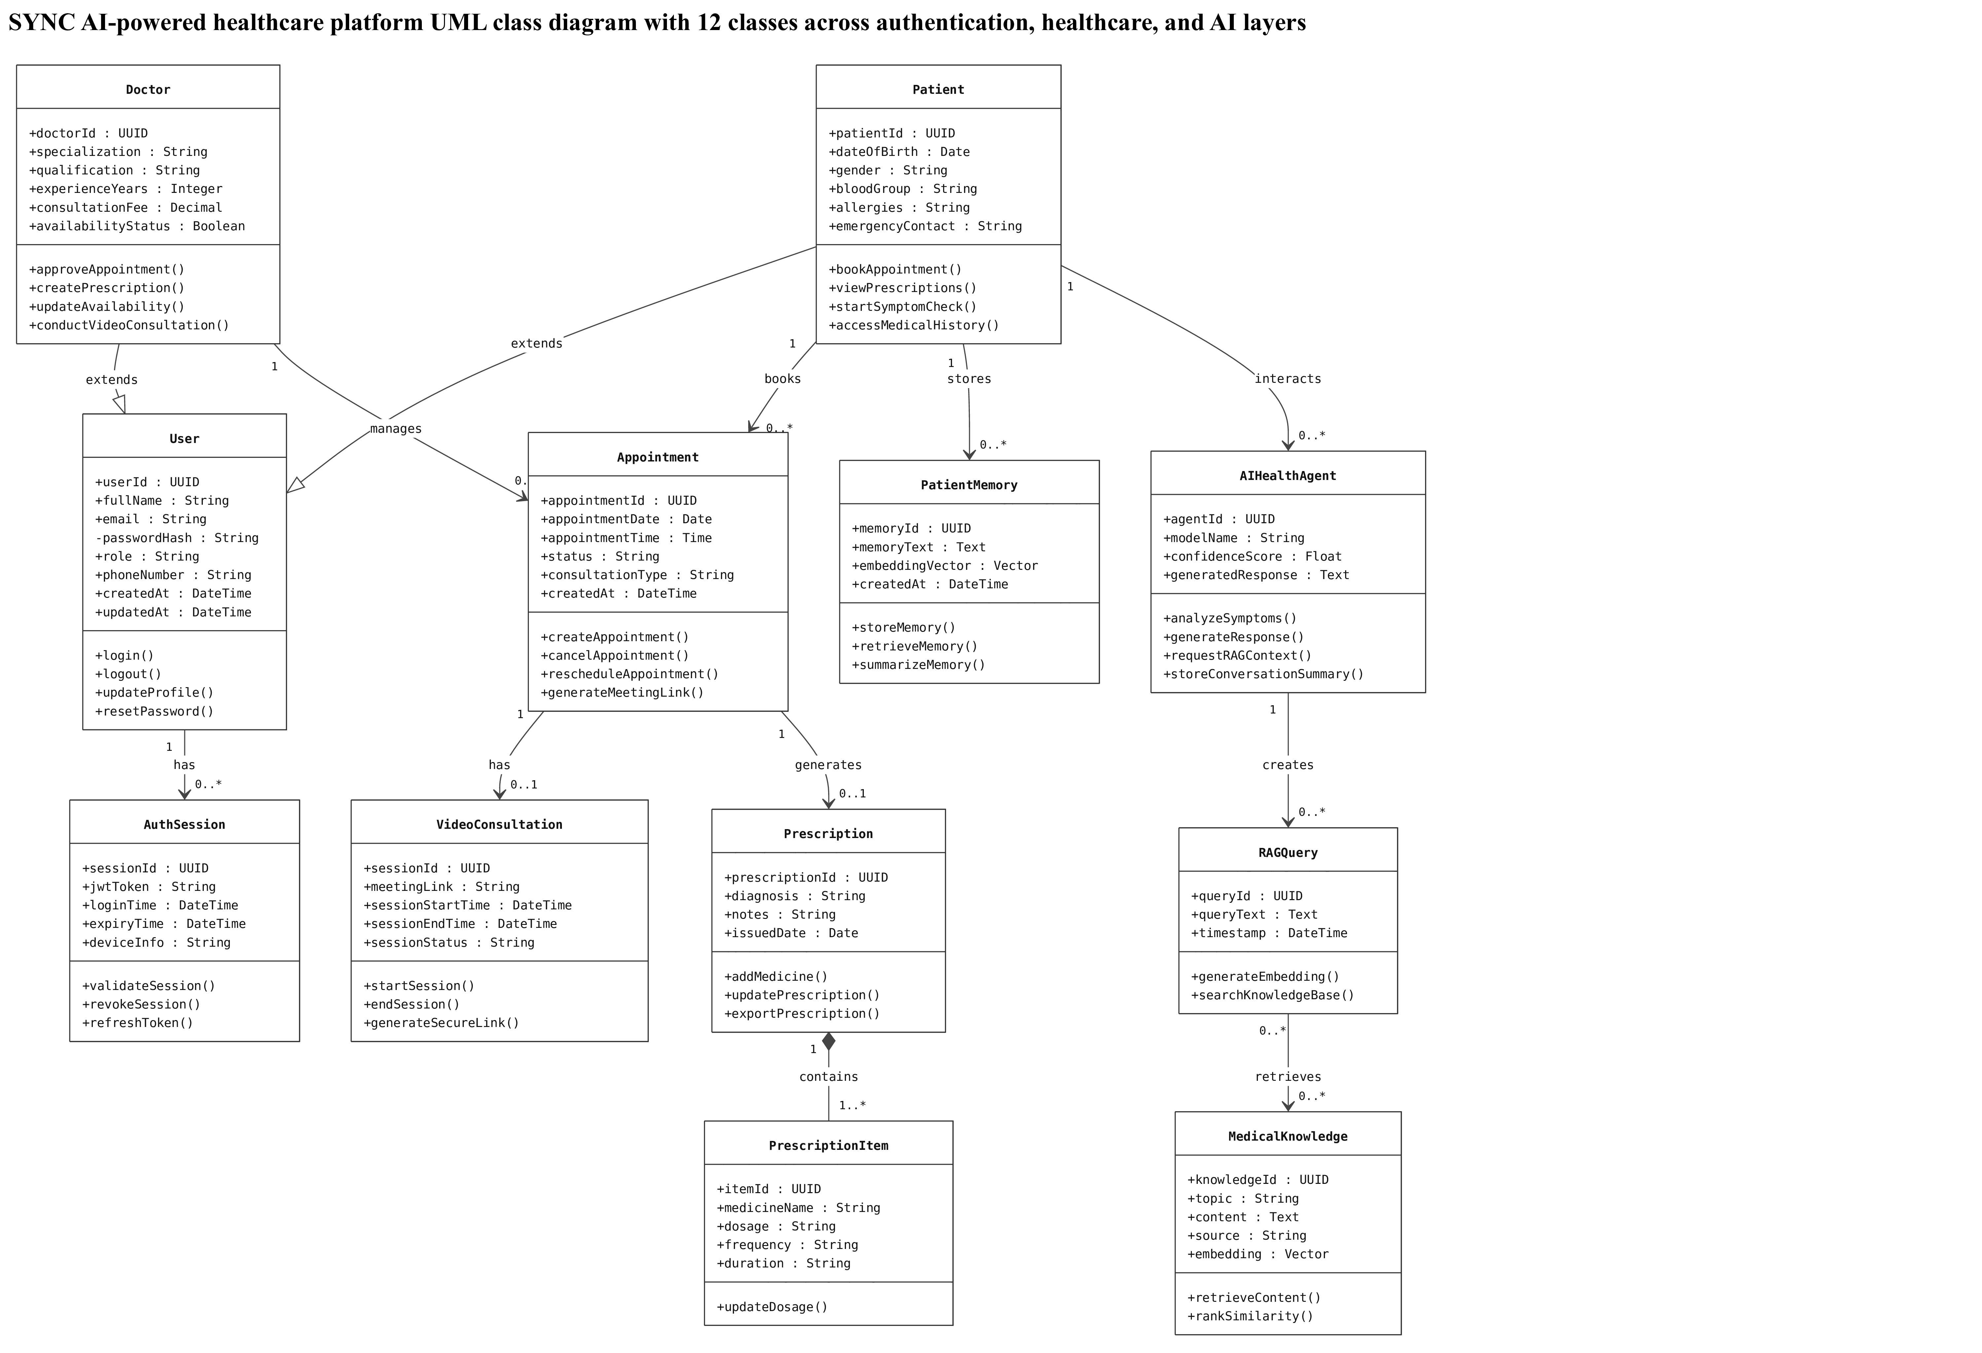
OBJECT-ORIENTED DESIGN
Class
Diagram
It includes authentication, healthcare, and AI-related classes.
Doctors and patients inherit common features from the “User” class.
The system supports appointments, video consultations, and digital prescriptions.
AI components provide symptom analysis and intelligent medical assistance using RAG.

Slide 16
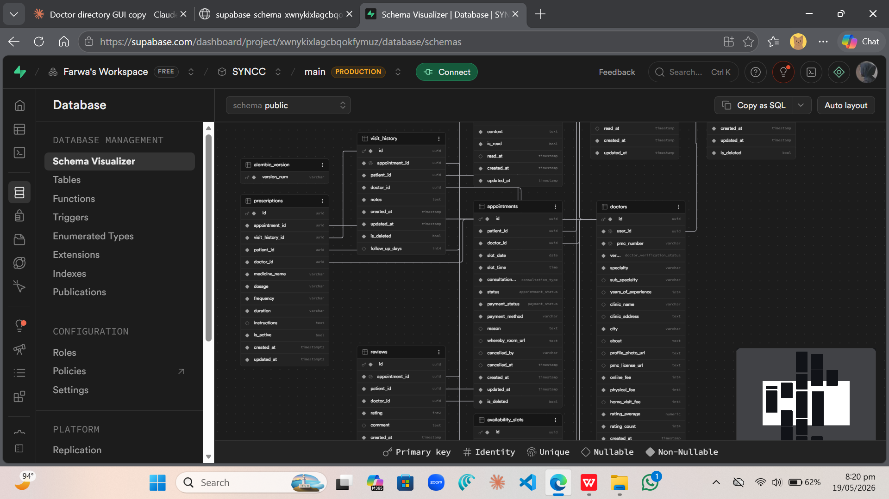
DATABASE DESIGN
Backend Database Schema
Real database structure behind the Sync app, built on Supabase. The schema visualizer shows how all the core tables: doctors, appointments, prescriptions, reviews, and availability slots are connected and talk to each other.
Every relationship is intentional. A doctor links to their slots, slots connect to appointments, and appointments tie back to both the patient and the doctor, keeping everything organized and traceable from one end to the other.
It's a clean, relational structure designed to handle the full cycle of a healthcare booking, from the moment a patient searches to the final prescription being logged.

Slide 17
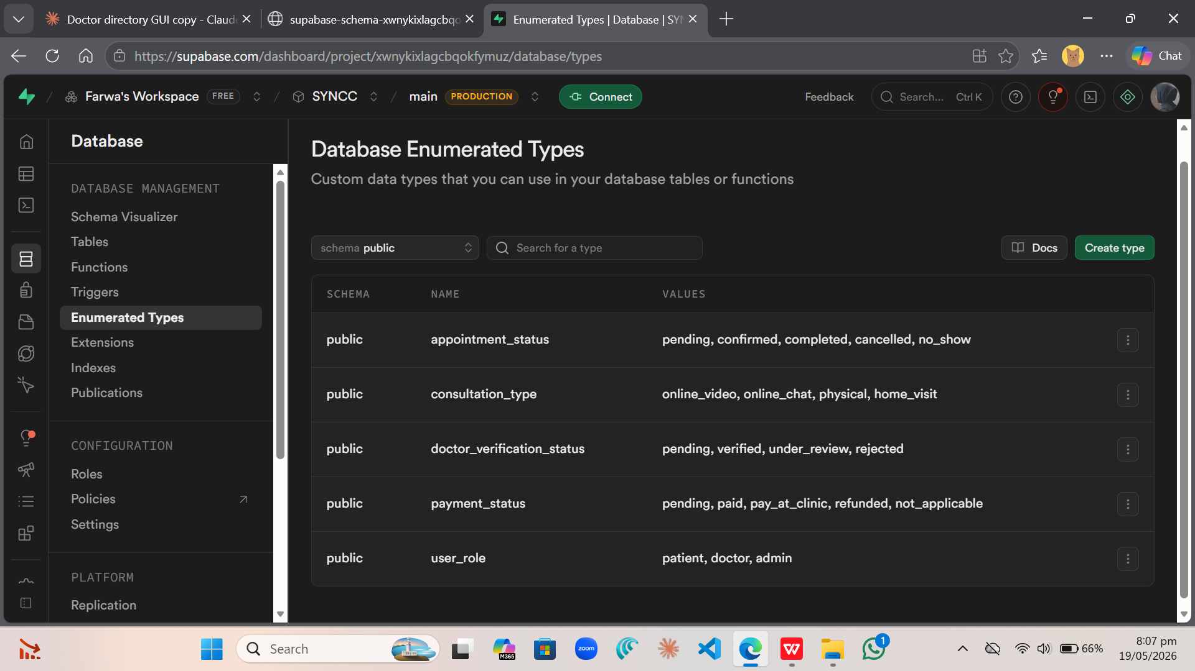
IMPLEMENTATION
Structured ENUM Types
Structured enum types keep data consistent across the app
Appointment status tracks every booking from pending to completion
Three user roles: patient, doctor, admin , each with controlled access

Slide 18
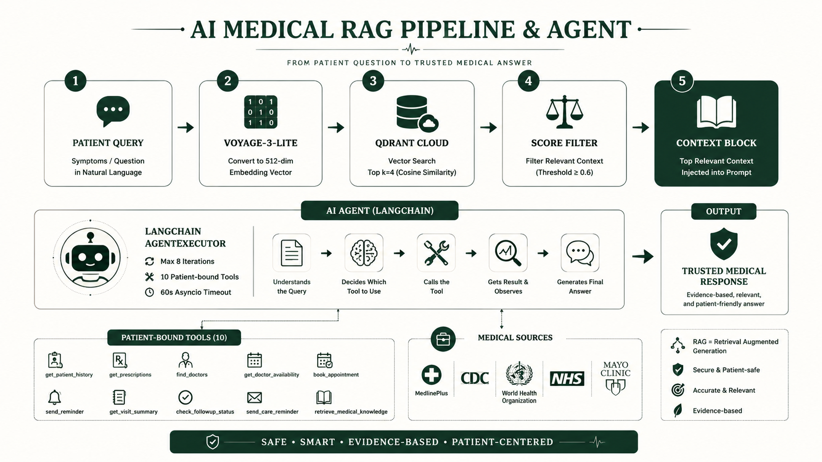
AI INTELLIGENCE LAYER
RAG Pipeline & AI Agent

Slide 19
SECURITY & QUALITY
Security Architecture + Testing
JWT Auth
Test Suite: pytest
Dual-layer: local decode first → Supabase API fallback. Token expiry explicitly checked.
test_api_auth.py
Registration, login, JWT, invalid token, role checks
bcrypt Hashing
Passwords never stored in plain text. bcrypt rounds applied on registration.
test_api_doctors.py
Directory, filters, profile, PMC verification flow
test_api_availability.py
Role-Based Access
Slot creation, update, delete, conflict detection
require_patient / require_doctor / require_admin on every protected route.
test_api_patients.py
Dashboard data, profile update, appointment view
UUID Identity
test_schemas.py
patient_id is always UUID. LLM only passes tool args — identity is injected.
Pydantic validators — phone, PMC, password strength
test_security.py
Soft Delete
bcrypt hash verify, JWT decode, expired token
is_deleted flag — healthcare data is never hard-deleted from PostgreSQL.
Playwright E2E
Login, registration, navigation, protected routes

Slide 20
🩺 Doctor Discovery
SYNC
📅 Appointment System
AI-Powered Healthcare Platform
for Pakistan
Thank You
🔐 Secure Architecture

